Slide 1

Security in Multi-tier Systems (part 02)
Best practices
Least-privilege
Authentication
Authorization
[ CS 308 / 350 / 354 ]

Slide 2

Security
Security is a large, complex field
Software
Hardware
Networking
Encryption
Authentication
Authorization
Best practices
…
apply as many of these as possible ("many lines of defense")
2

Slide 3
Best practices
The most common:
Don't store passwords in clear text
Input into program variable, immediately use, clear variable
Store hashed version in database, not actual password ("hash" => one-way encryption, see project 04)
Don't store credentials / keys on the client
And if possible, eliminate use of keys altogether
Encrypt communication with web server, RDS, S3, etc.
Web server with https; RDS by opening connection with SSL/TLS
Encrypt data at rest (e.g. assets in S3)
Principle of least-privilege
3
Notes:
SSL = secure sockets layer (deprecated)
TLS = transport layer security (new std)

Slide 4
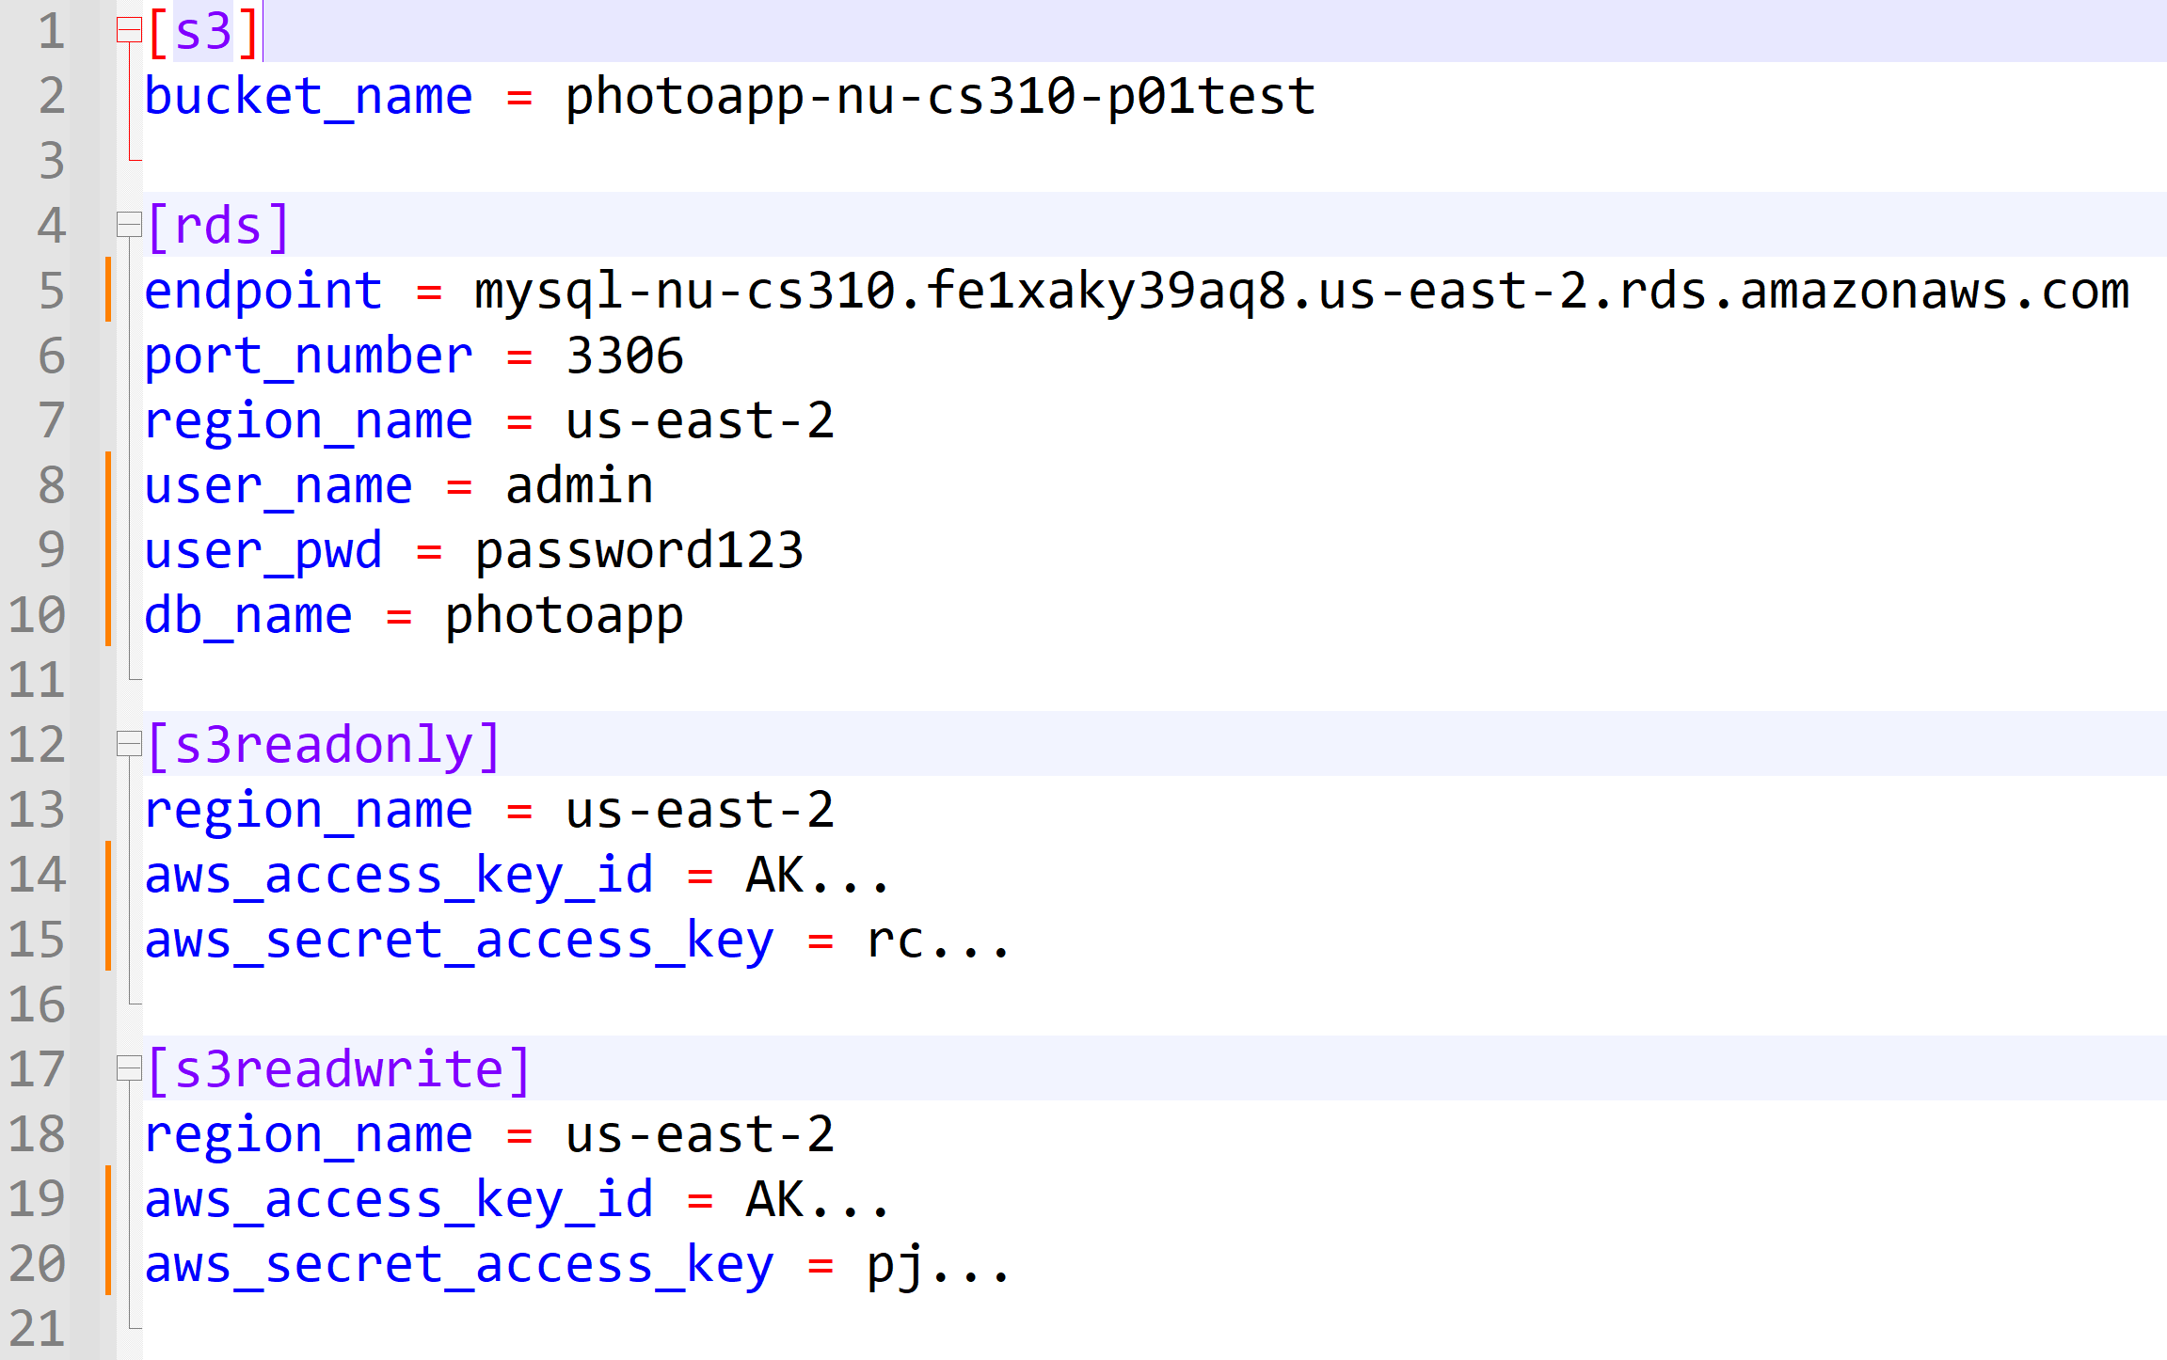
Principle of least-privilege
"Provide just enough permissions, no more"
Example:
Lambda function needs to read data from MySQL
Is the following "config.ini" good or bad?

Slide 5
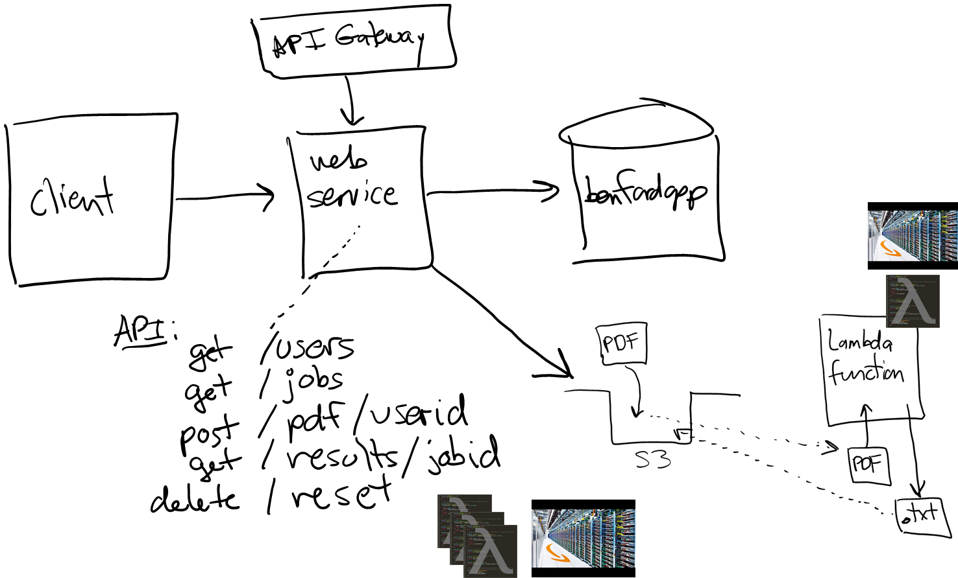
users
Software executes under some identity ("user")
That identity dictates what the software can do…
5

Slide 6
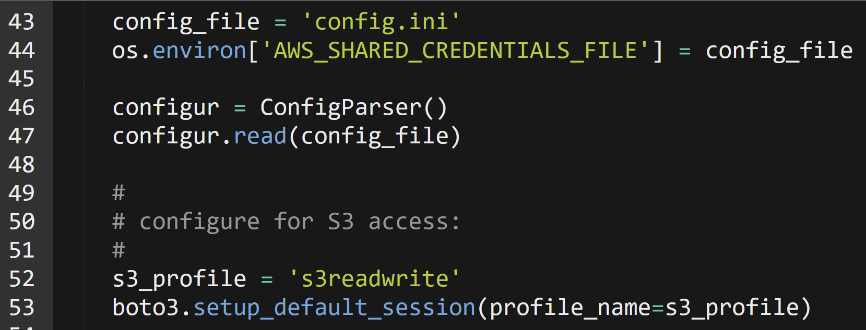
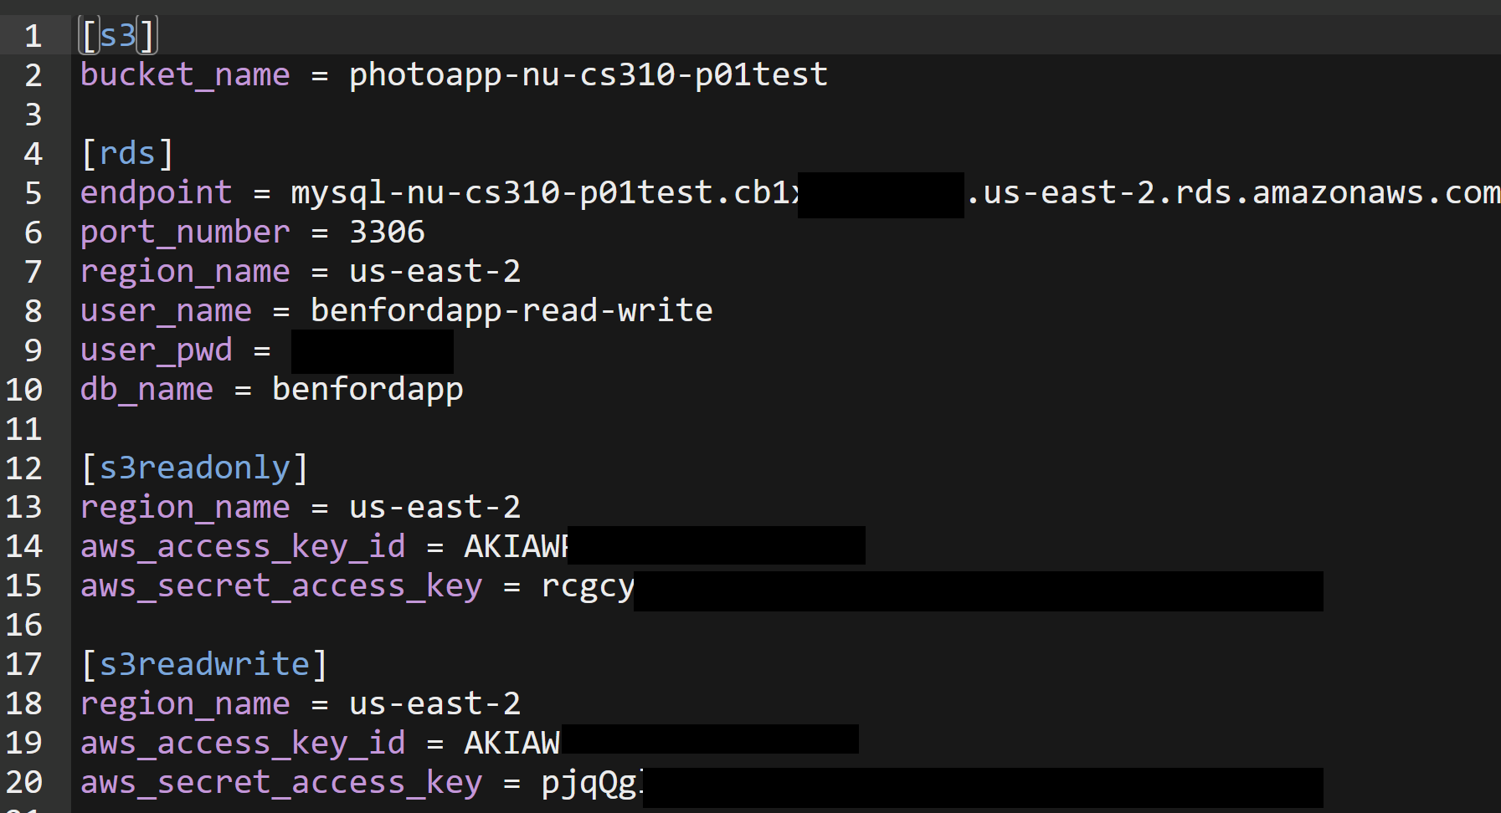
Example: "users" in project 03
benfordapp-read-write
s3readonly
s3readwrite

Slide 7
authentication vs. authorization
Authentication: who are you?
Authorization: what are you allowed to do?
7

Slide 8
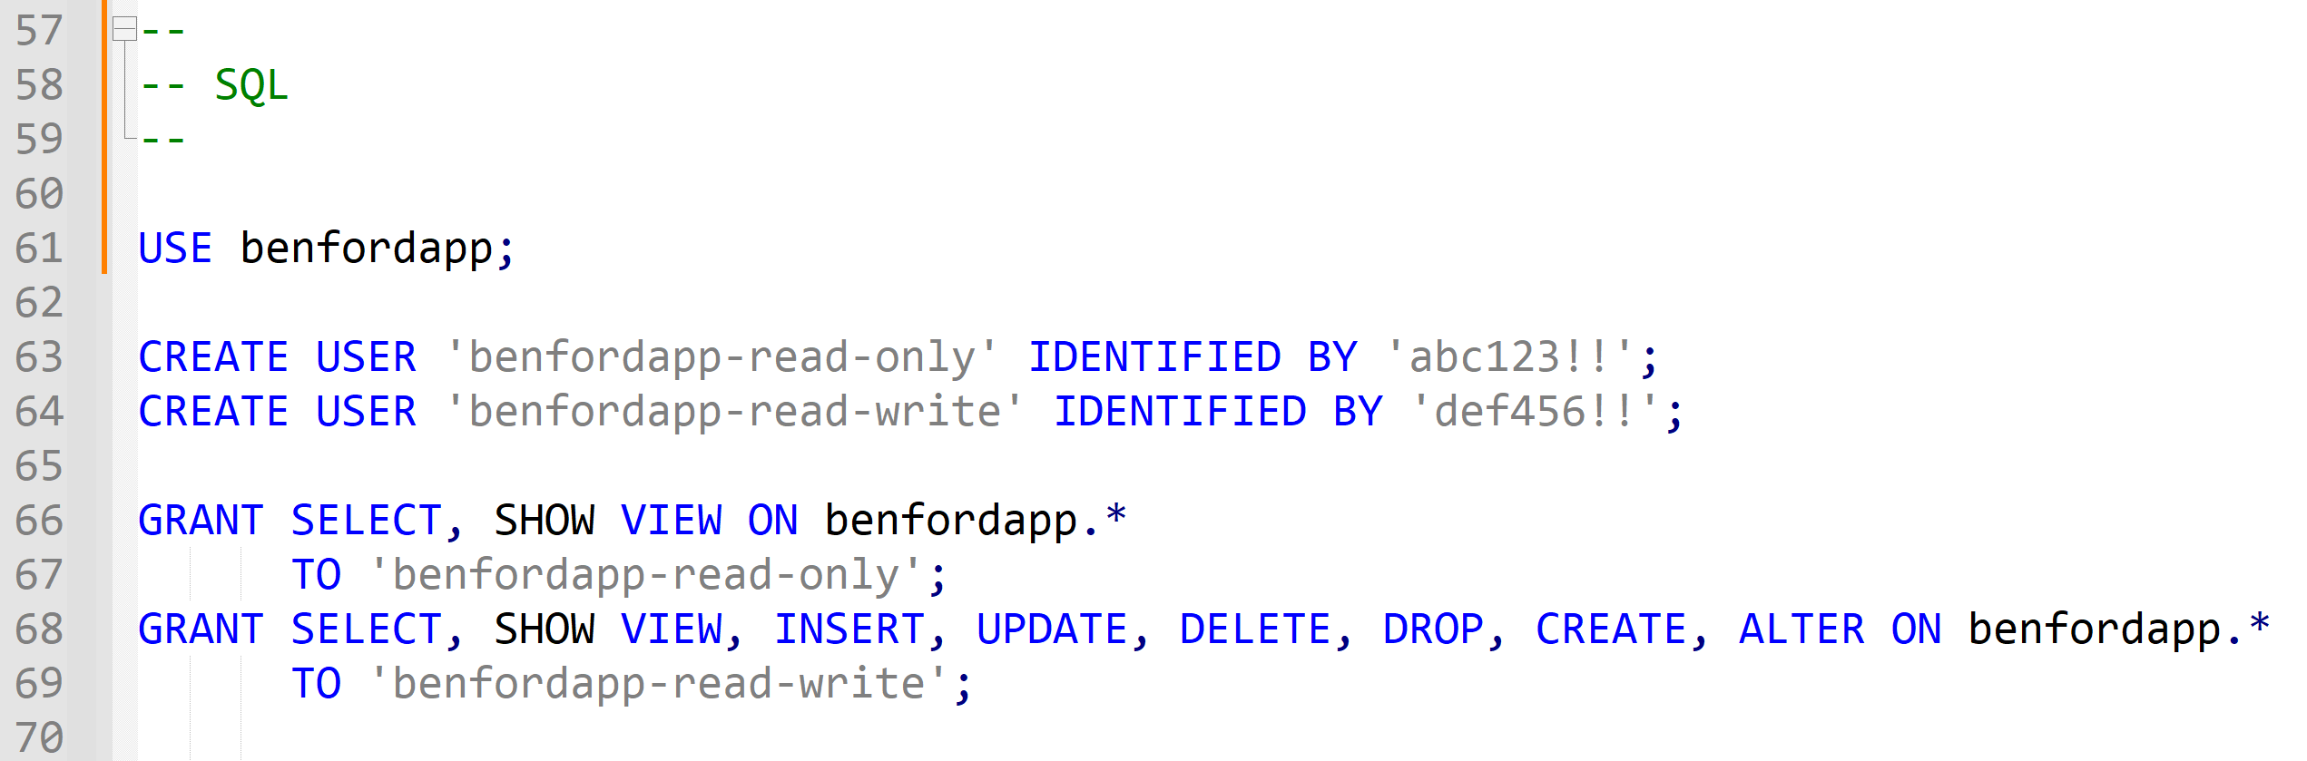
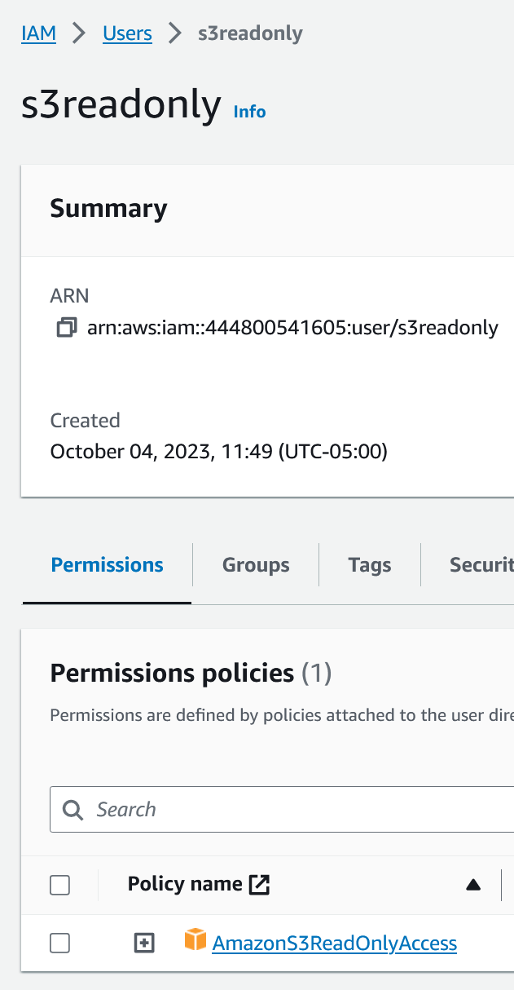
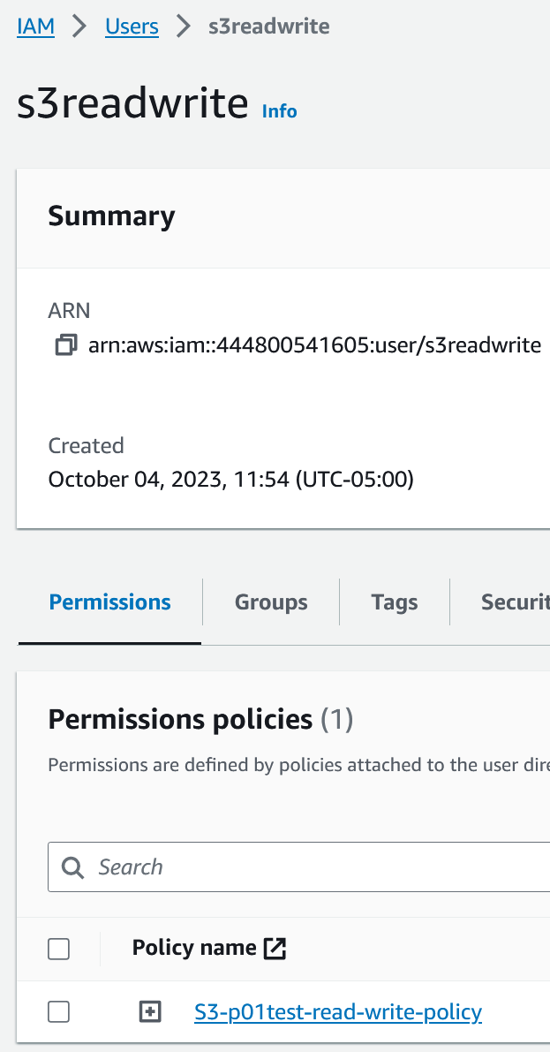
Example: project 03

Slide 9
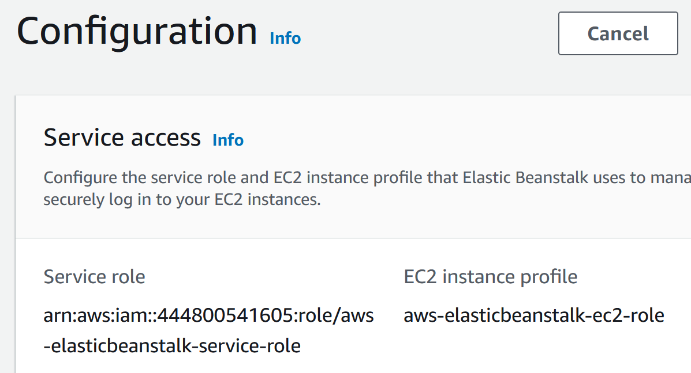
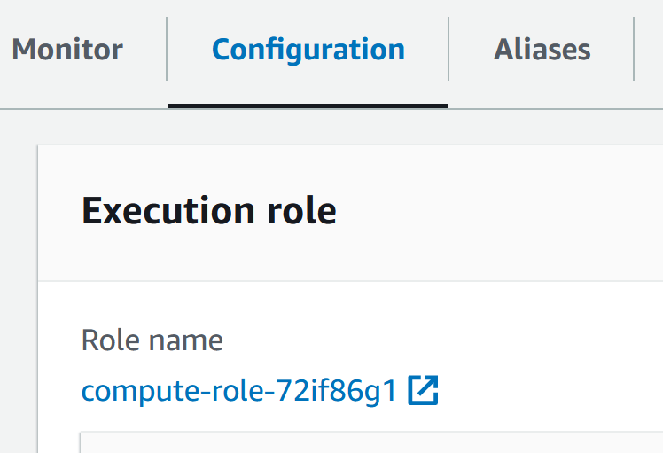
Moving away from access keys
Access keys are generally not a good idea
They get embedded into code and hard to change
Easy to leak out (e.g. upload to GitHub --- AWS will detect!)
On server-side, assign permissions to users / roles
Example: assign RDS and S3 permissions to EB instance
Example: assign RDS and S3 permissions to lambda functions
9

Slide 10
Demo: access keys => add policy to lambda role
Project 03
Open proj03_upload lambda:
Comment out code that sets s3_profile, calls boto3.setup_default_session( )
Test upload --- it will fail
Configuration tab… Permissions…
Click on "arrow" next to Role name
Now looking at role in IAM
Add permission…
Attach policy…
Find S3-read-write-access policy
Select
Add
Run and test --- should work!
Can now delete S3-related keys…
Notes:
Interestingly, repeat with download function, which only needs read access --- it works WITHOUT having to add read-only policy. Why is that you think? [ Because it already has read access to S3 to obtain layer(s) it needs to run. ]
NOTE: add "s3-p01test-read-write-policy" in our case

Slide 11
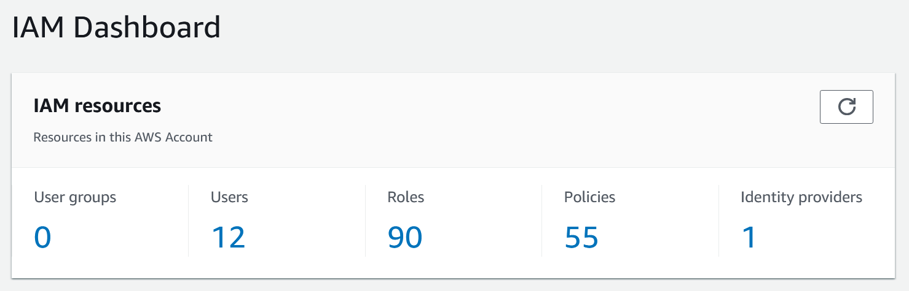
IAM
AWS Identity and Access Management service
Critically important service for security
Create 1 user per client?
Create 1 user for ALL clients?
Use groups to categorize users?
Define common policies, attach to roles / users / groups?
11
Notes:
User: identity with longer-term credentials; only users can be added to groups
Roles: identity with shorter-term credentials
Policies: define permissions

Slide 12
That's it, thank you!

Slide 13
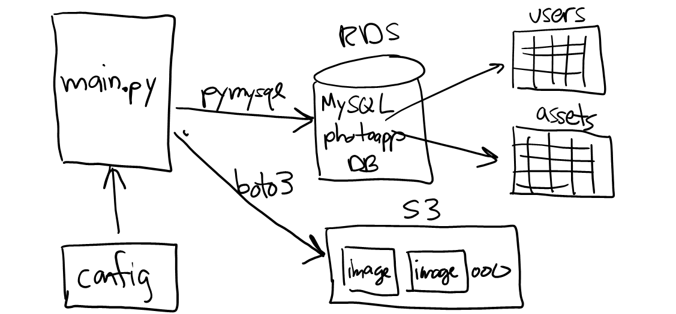
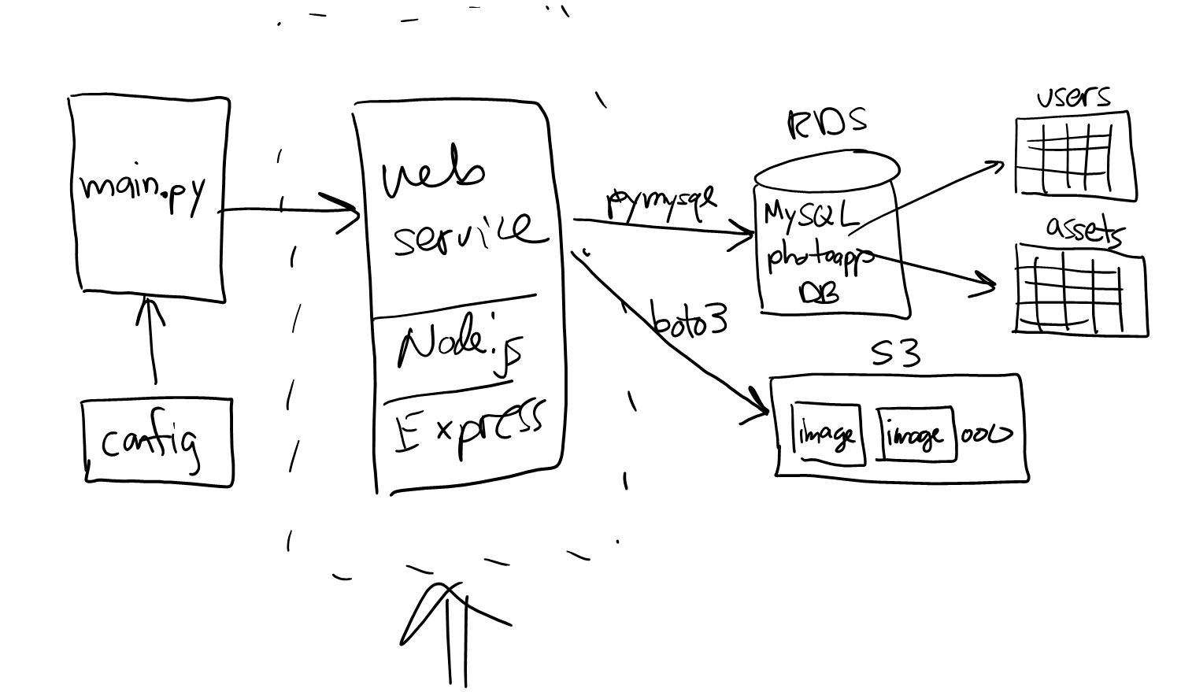
Distributed systems
Cloud-based apps are distributed systems
N > 1 computer programs communicating via messages
All our projects are distributed systems:

Slide 14
Increasing security
Project 01 stored credentials on the client --- this is not secure
How to improve?
Configure IAM user in AWS with a password, prompt user
Configure IAM user in AWS to enable MFA (multi-factor auth)
Use a multi-tier approach… (aka Project 02)
14

Slide 15
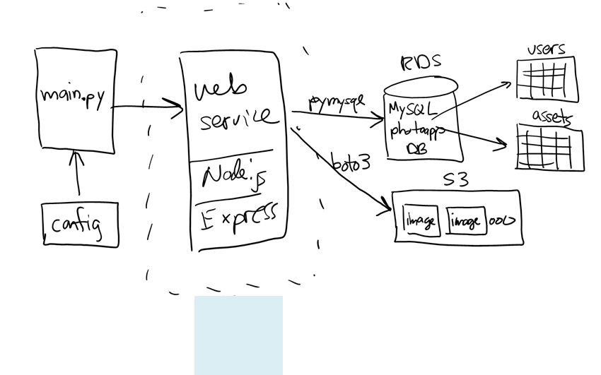
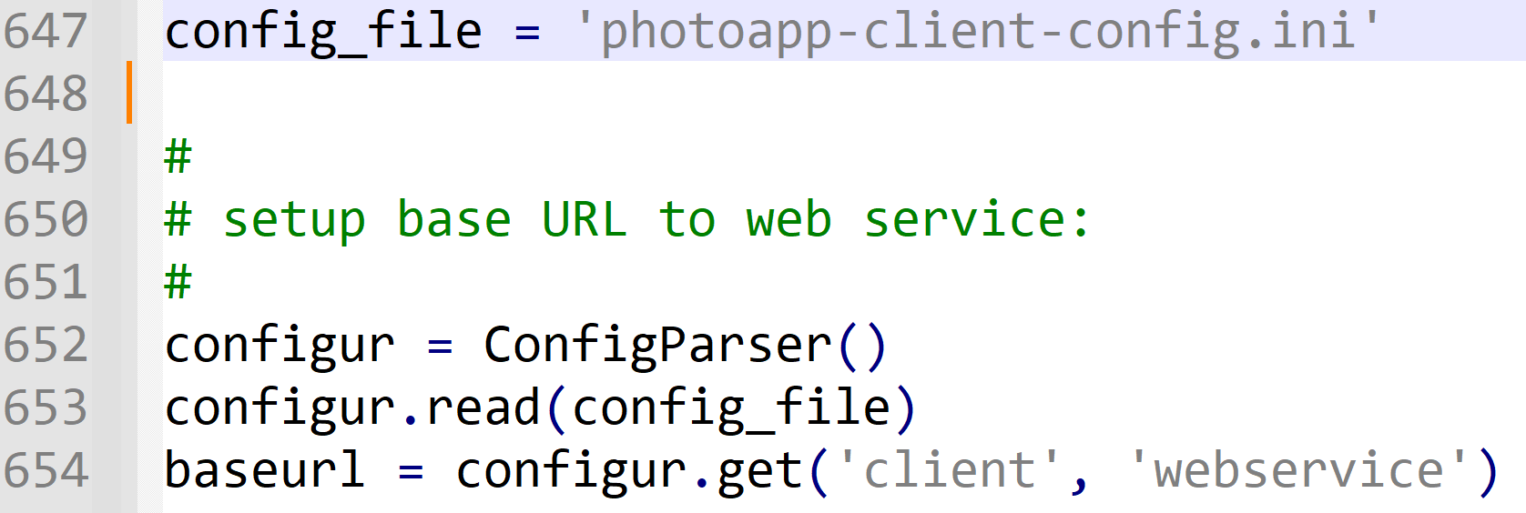
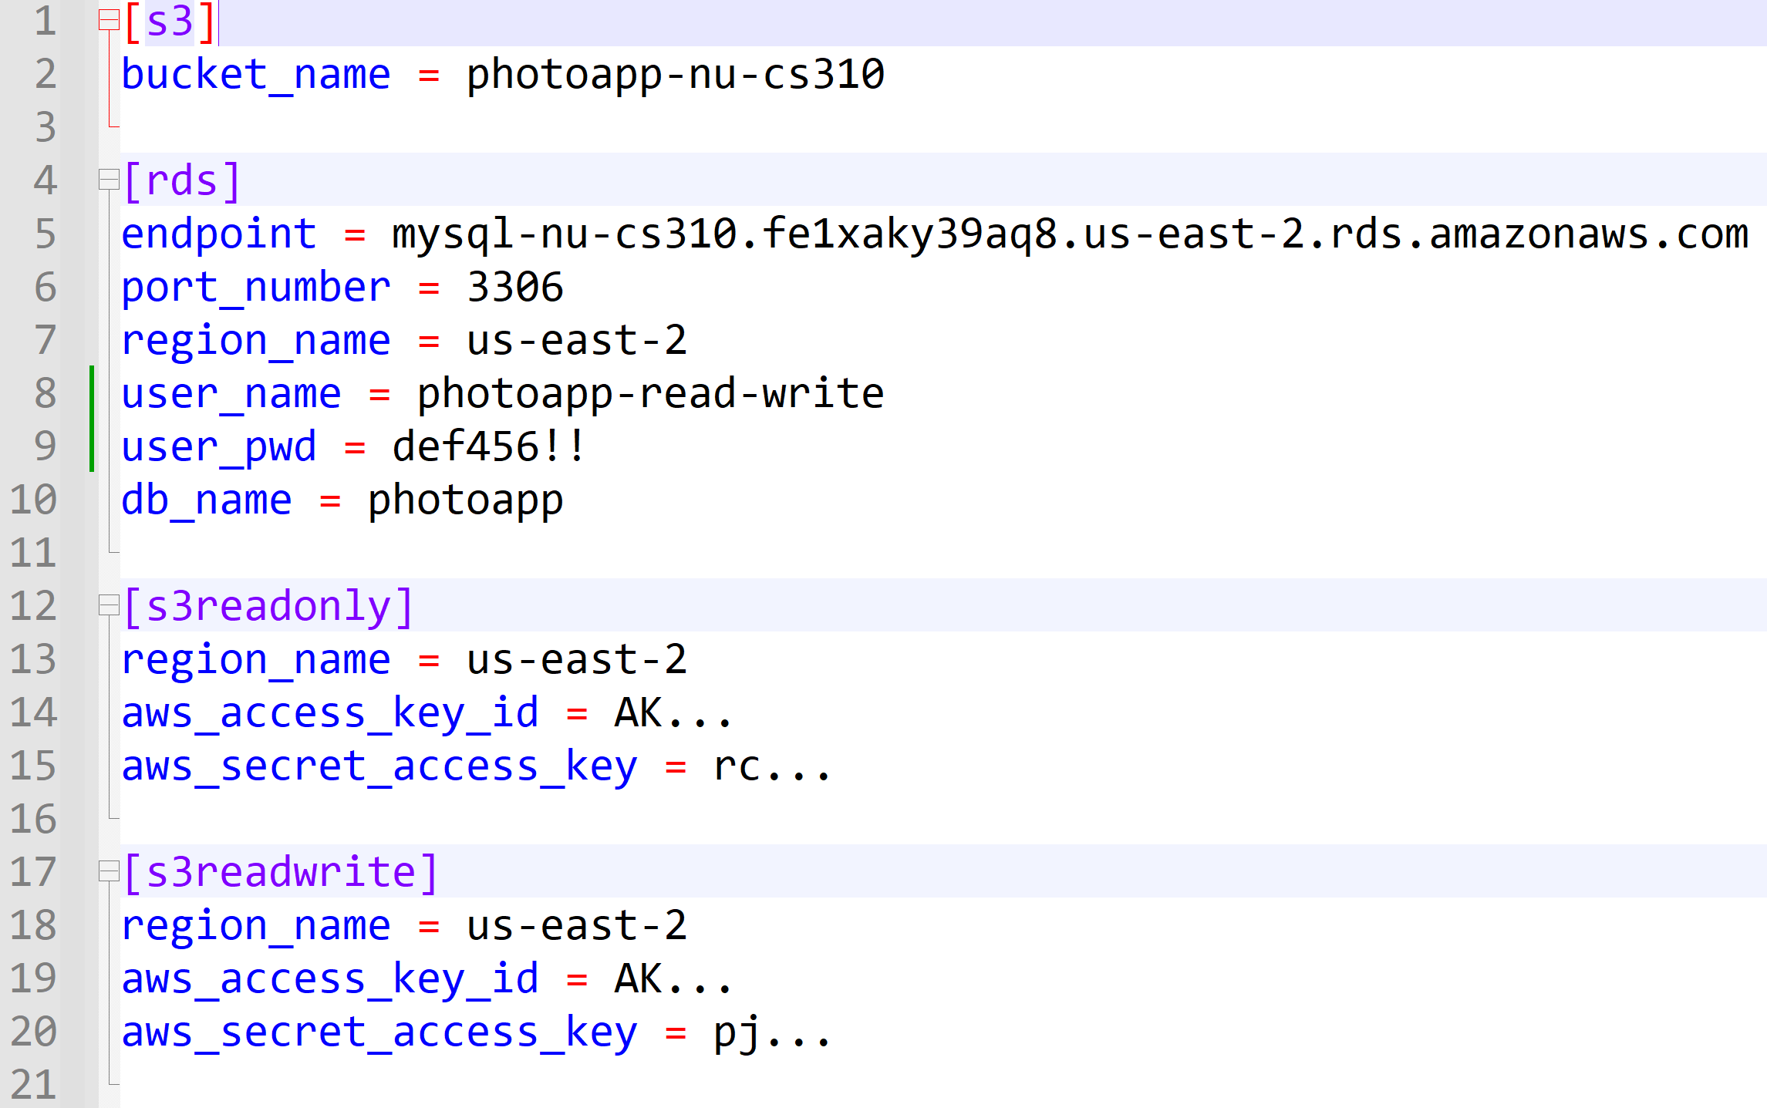
Example: project 02

Slide 16
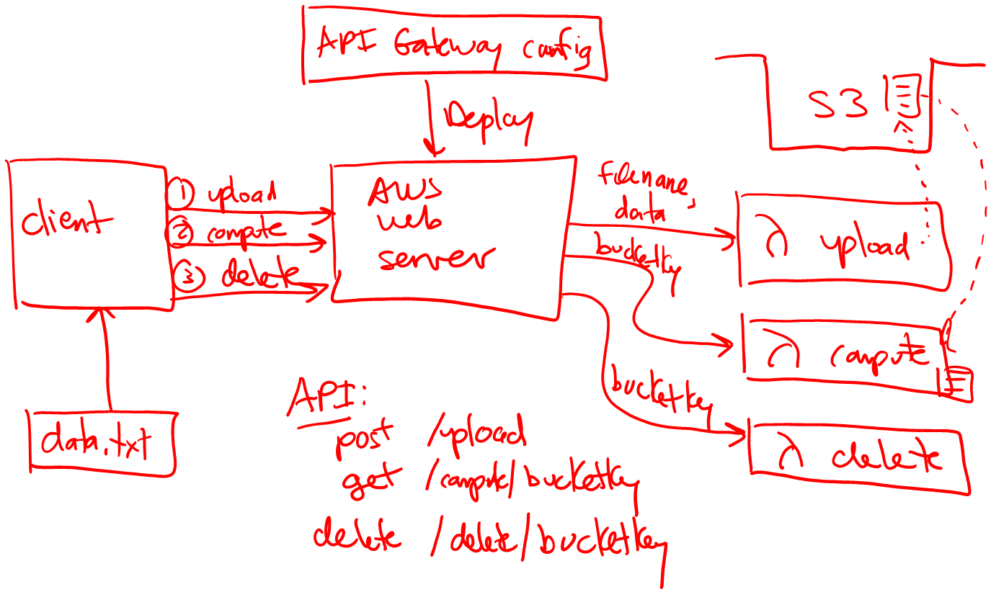
Example: serverless app from Lecture 14

